Slide 1

EOL RF Receiver Tester

Slide 2
Problem Statement:
1- testing of RF modules takes a lot of time for every test , there is an individual test jig.
2-we can’t monitor if the module pass test cases or not.
3-different documentations needed to make test , so it’s hard for operators to follow this.
4-operators miss labels for some RF modules.

Slide 3
Objectives:
1-minimize the test setup in one test jig.
2-control all testing process.
3-decrease the testing time.
4-automate the whole testing process.

Slide 4
RF Frequencies:
* RF Modules divided into set of frequencies in MHZ*
434
458
419
429
869
447
1216
480
2400

Slide 5
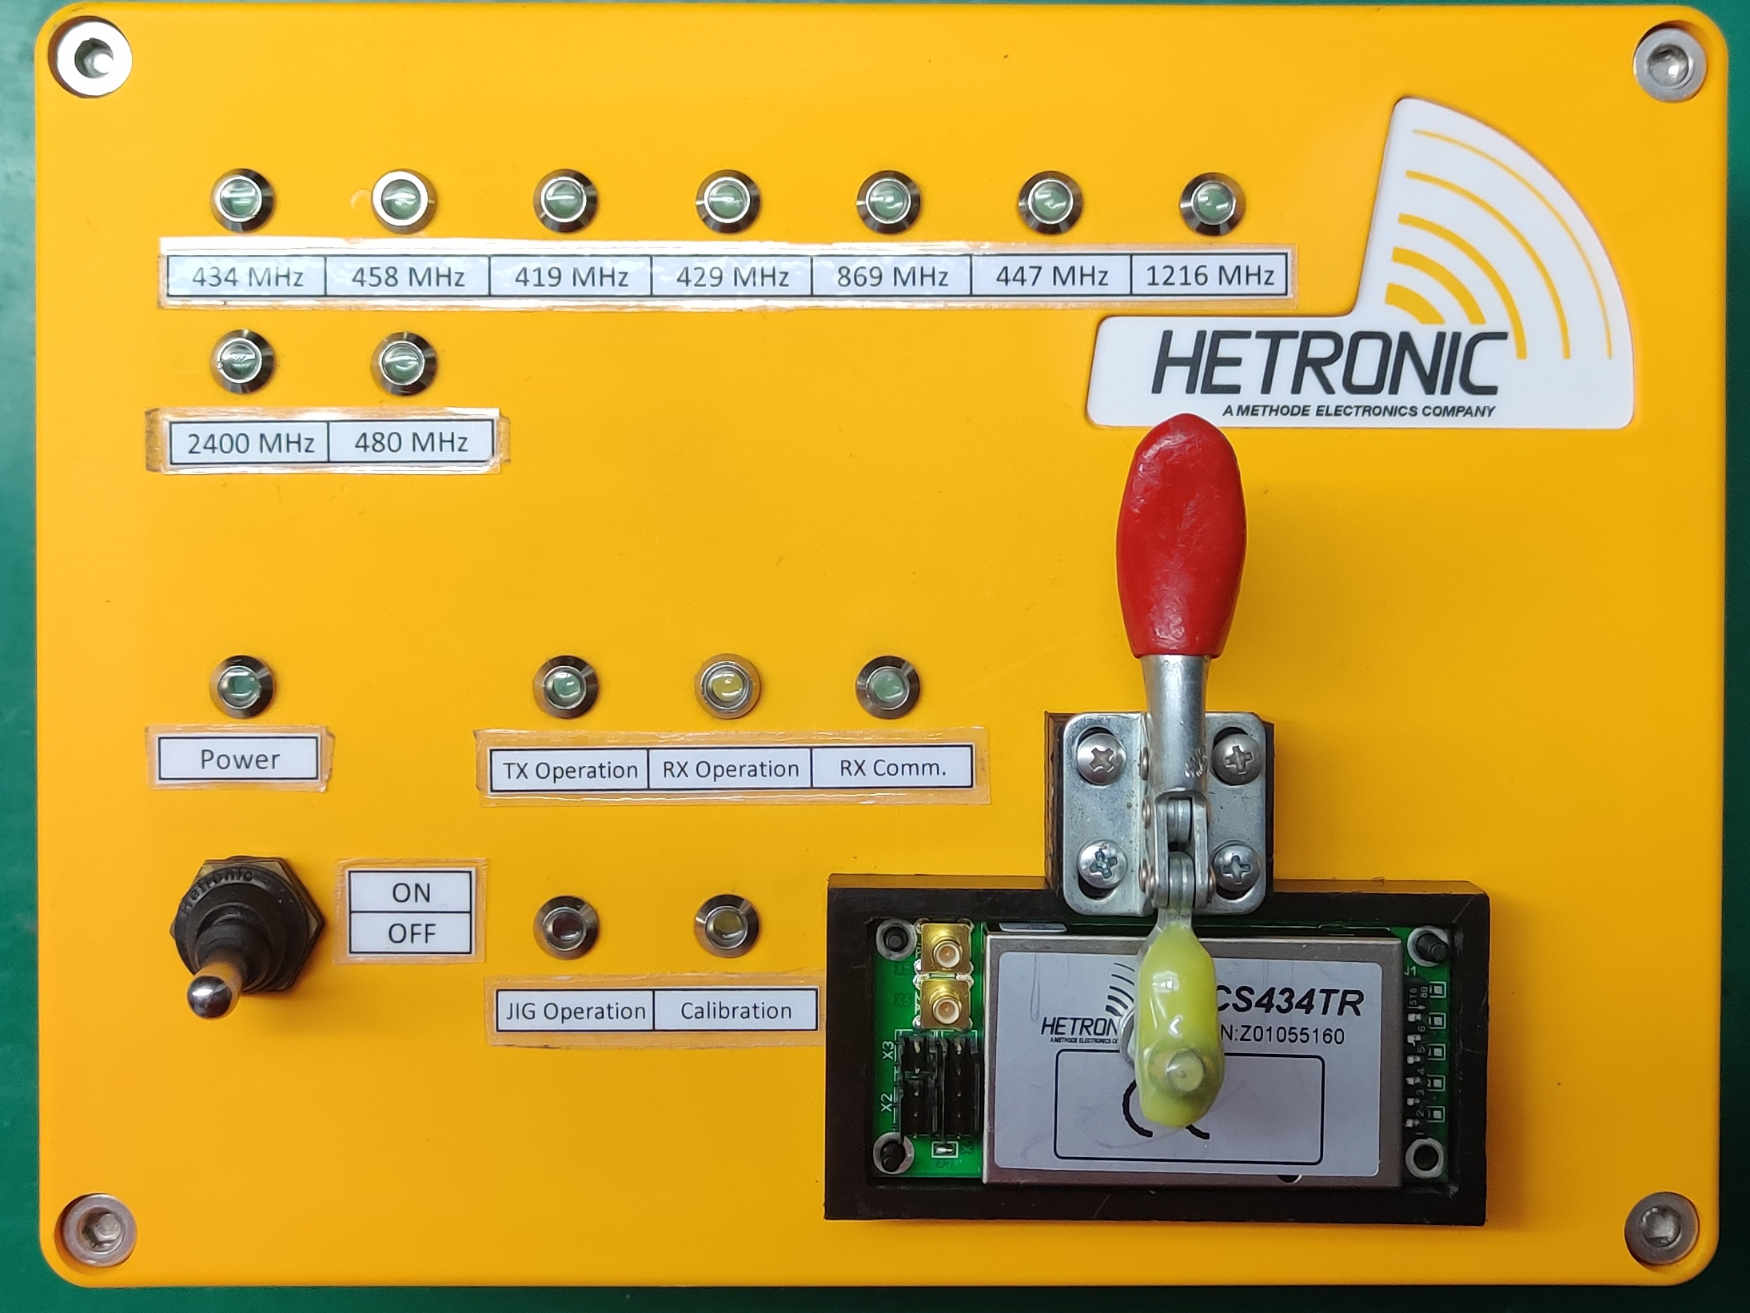
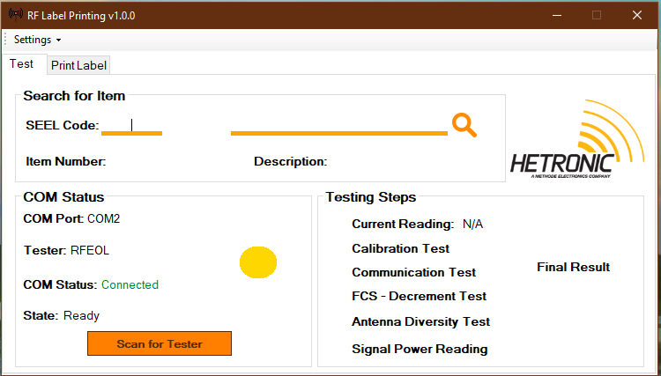
End Of Line Tester for RF modules
Tester
Application
Advantages:
Automatic RF Label Printing
Label is automatically printed with correct format if unit passed full test based on the model detected from the scan sheet
Automatic Logging
Each time the user tests the unit, the application saves the entered data in excel sheet with date & time
Ensuring that all test steps are performed correctly
The application detects the model & select the testing modes for this model based on the WPI
Automatic scan for tester
The application scans for the tester & automatically detects the JIG
5

Slide 6
RF-Test Jig
ERGO-5(TX Board)
ES-SCAN(RX Board)
Built in
TX – RF
RX – RF
Tested module

Slide 7
Model | Testing performed
TRT | Current consumption
 | Calibration
 | Communication (on 5 fixed channels)
 | Communication on scan group & decrement test
 | Power reading
TRR | Current consumption
 | Calibration
 | Communication (on 5 fixed channels)
 | Communication on scan group & decrement test

Slide 8
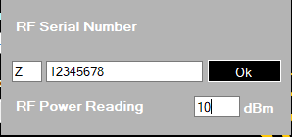
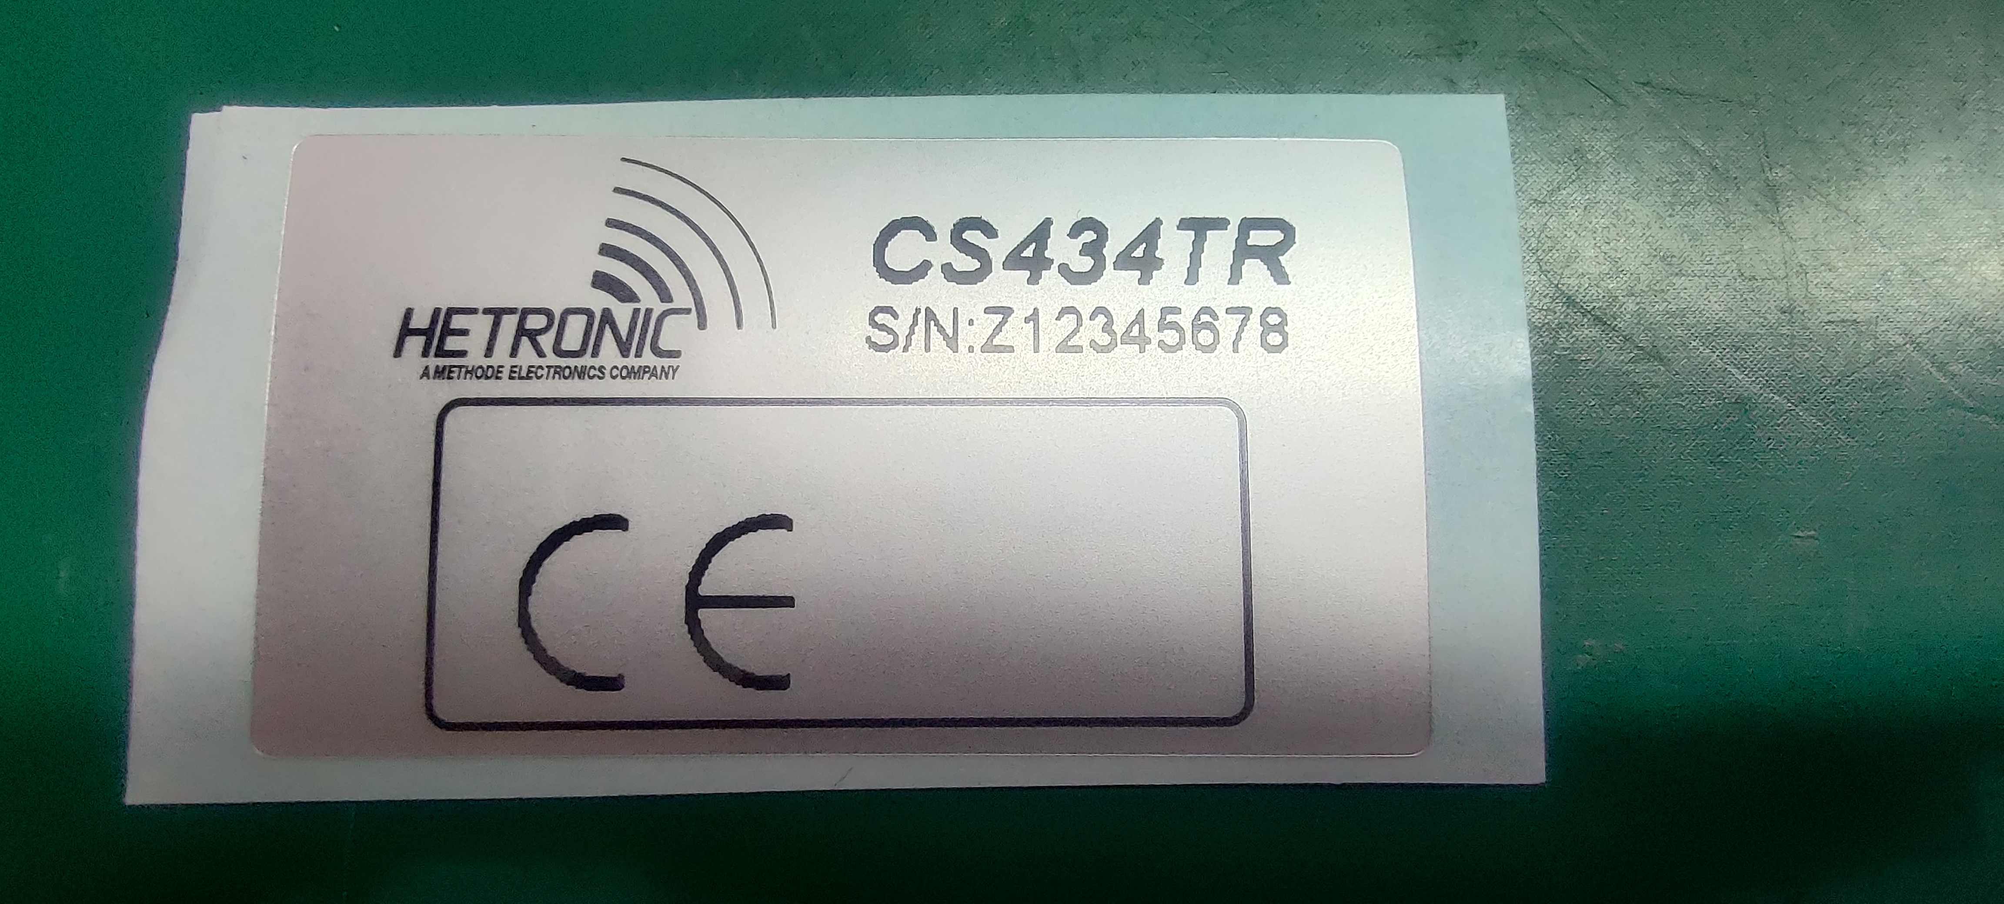
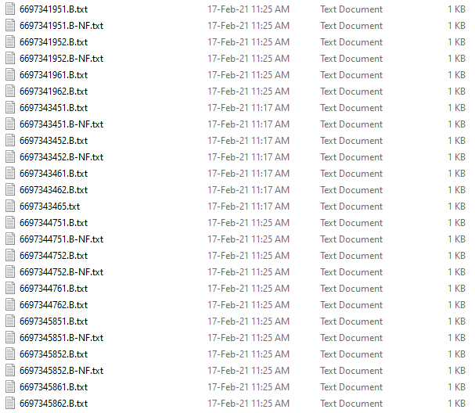
End Of Line Tester for RF modules
Scan for tester
Enter SEEL code & scan sheet data
Perform full unit test
Printing RF Label & Logging
Once the item on the scan sheet is entered the application detects the model & selects the testing modes for the entered item
Finally the application saves the entered data in excel sheet & prints label with entered serial number with the correct format if unit passed all tests
Once button is pressed the application starts communicating with all available communication ports & detects the correct com. Port that the tester is connected to
By scanning the item number on the scan sheet of the item to be tested the application fetches the label format from the database location
Once finished the user is asked to enter the RF serial number & power (if required for the selected model)

Slide 9
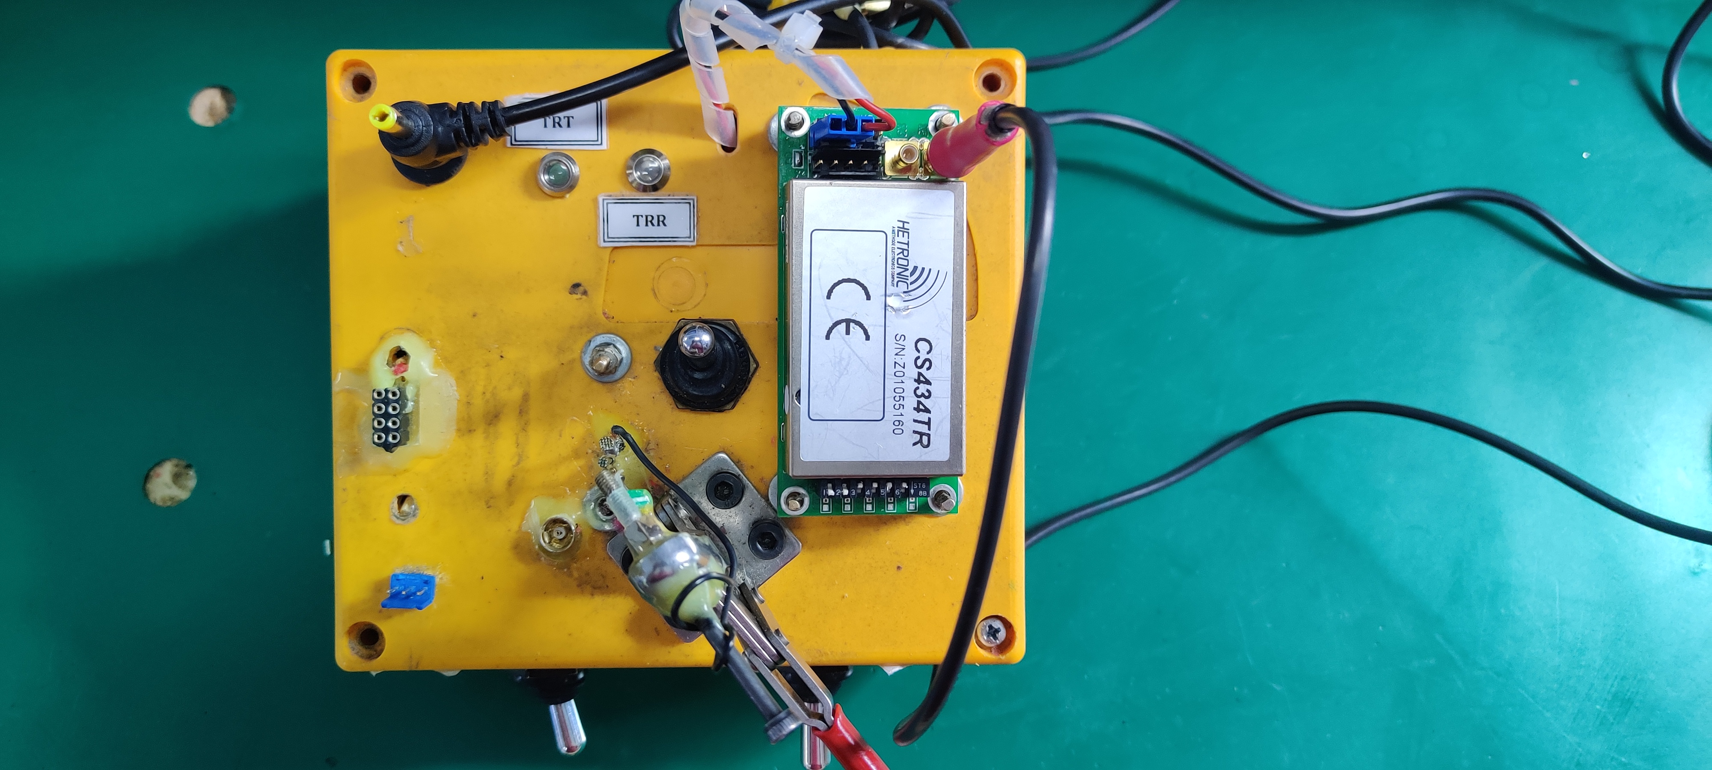
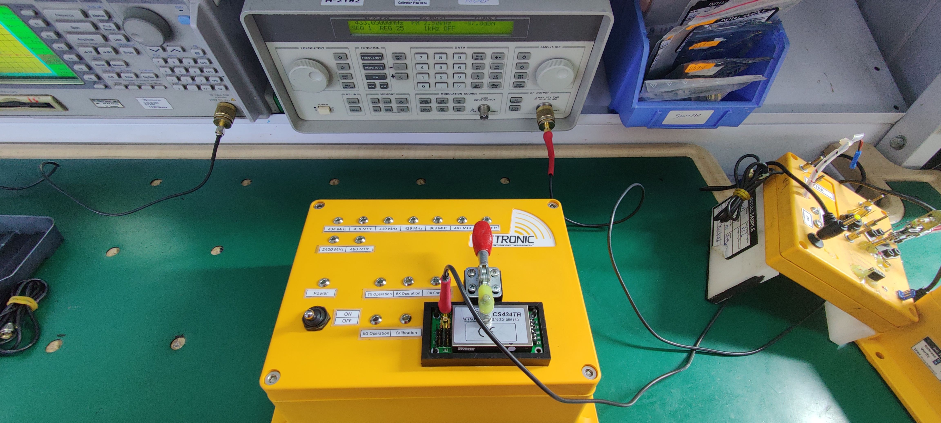
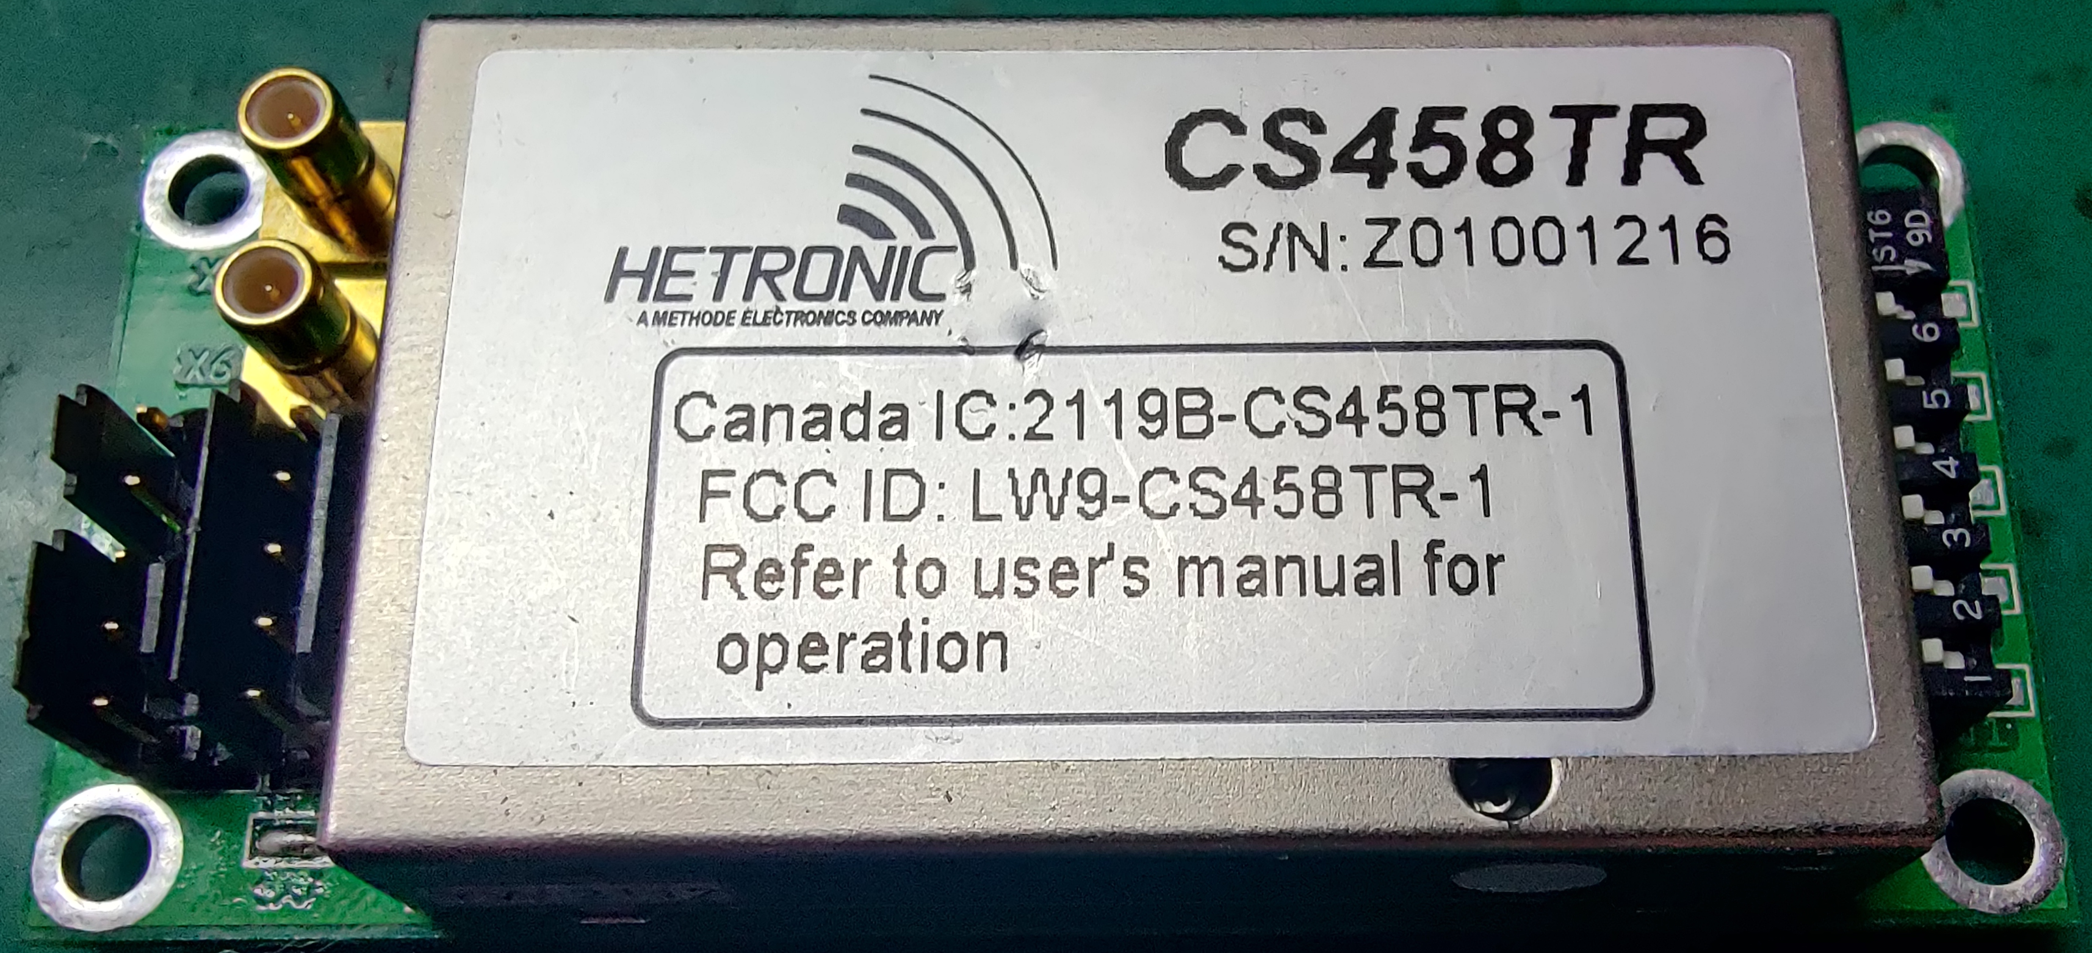
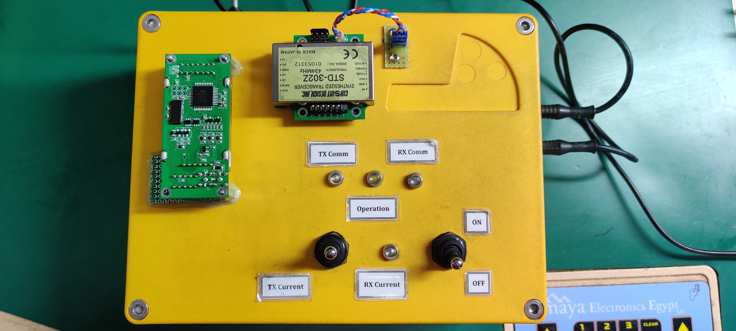
Semi-Automation Projects
Calibration JIG
Communication JIG
Unit
RF EOL JIG
Old Setup
New Setup
Total time 4.40 mins
Total time 1.20 mins

Slide 10
Thank You

